Slide 1
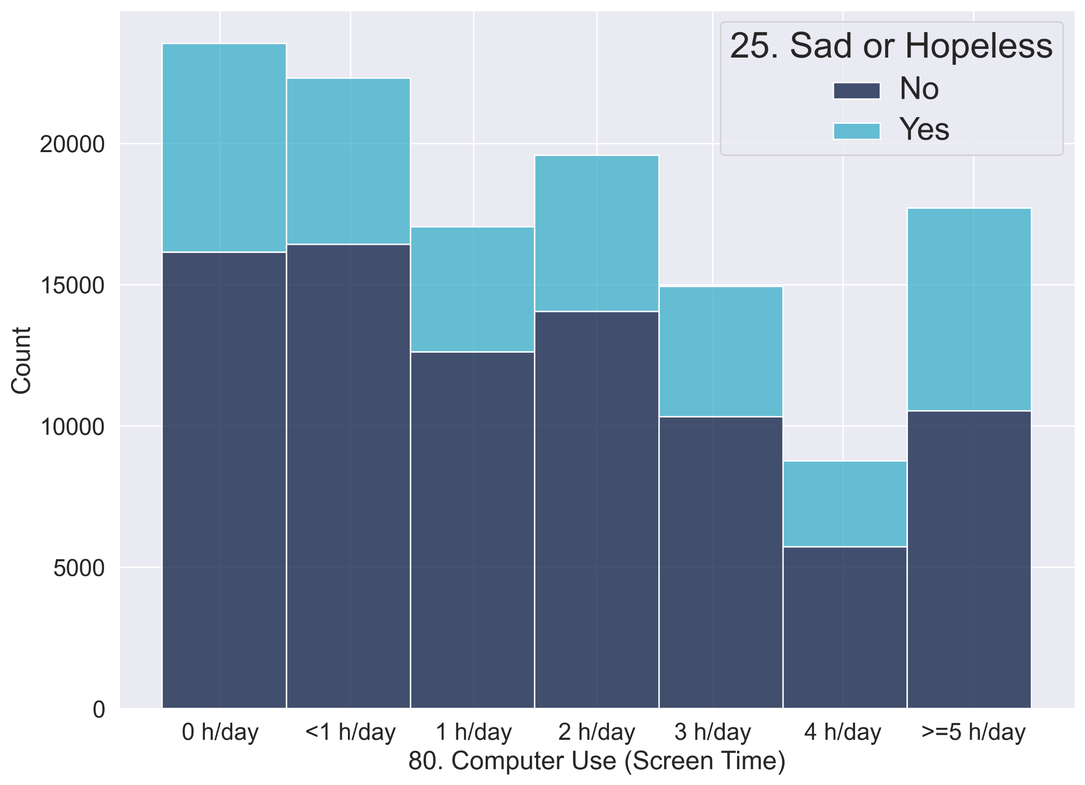
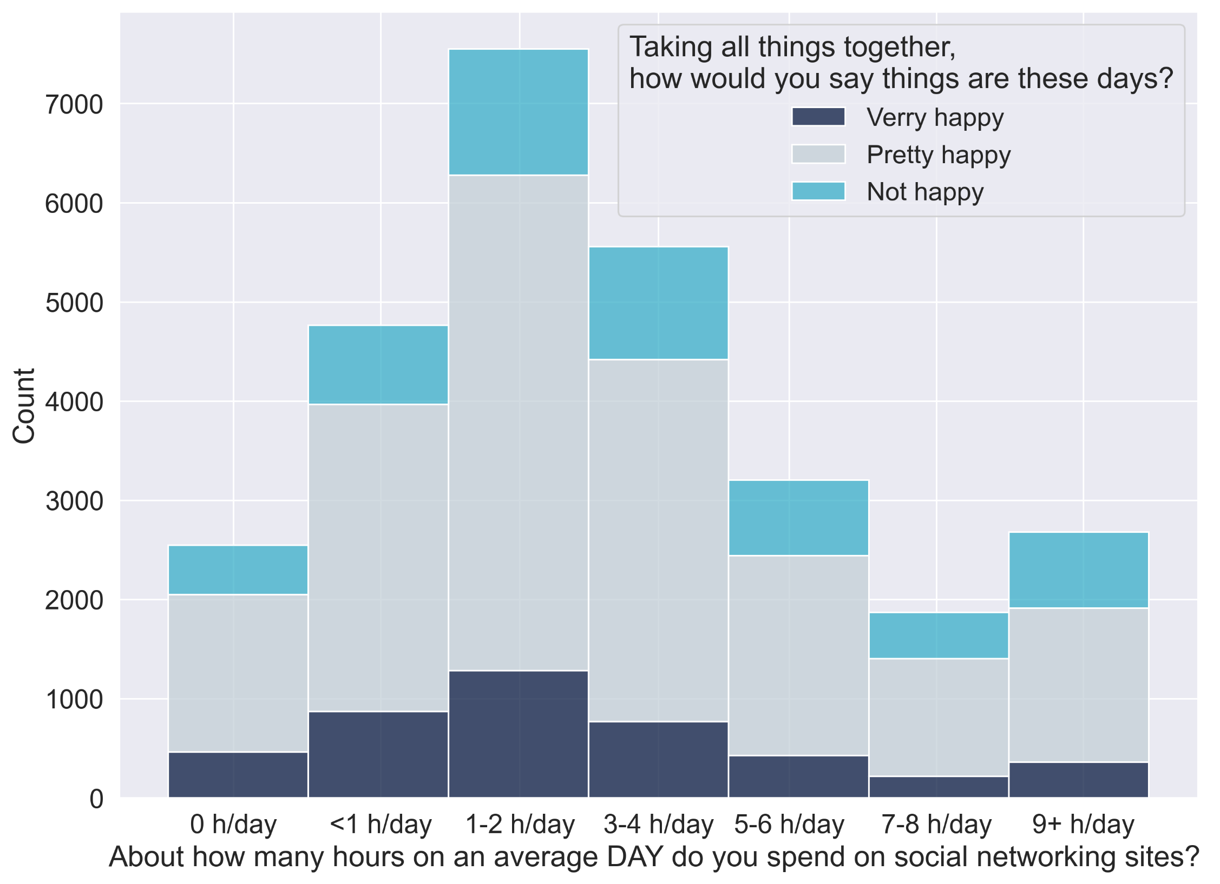
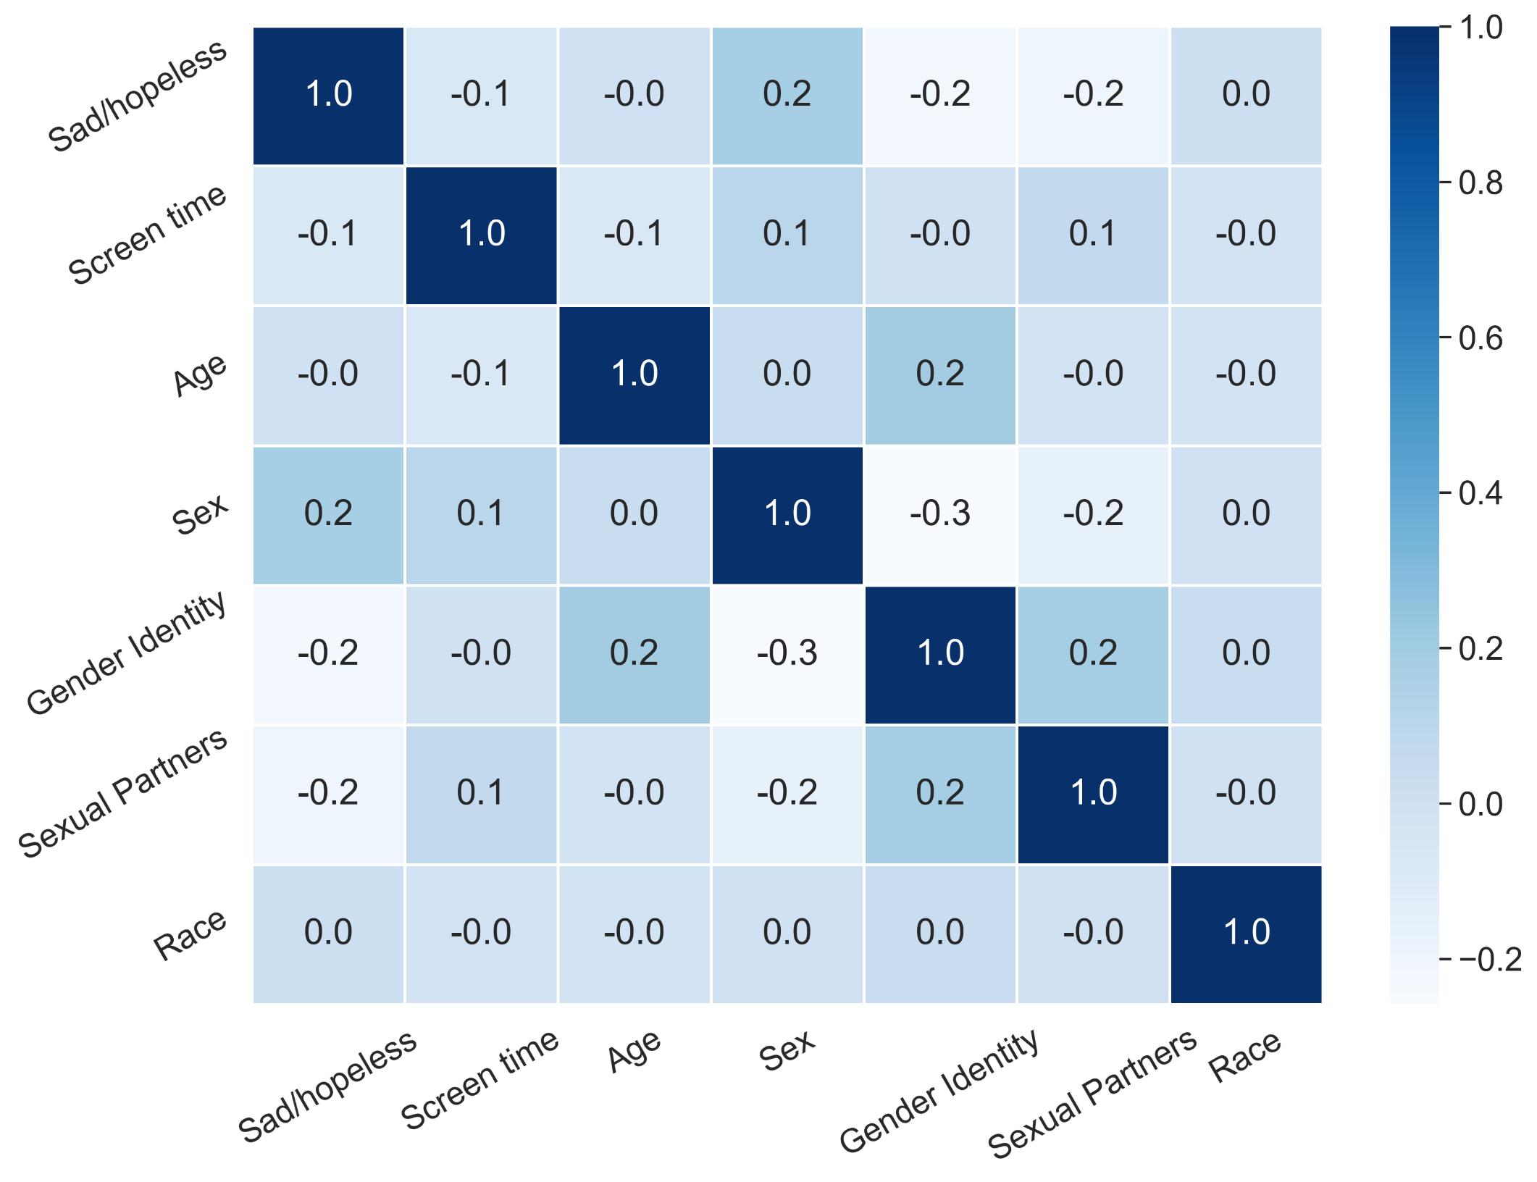
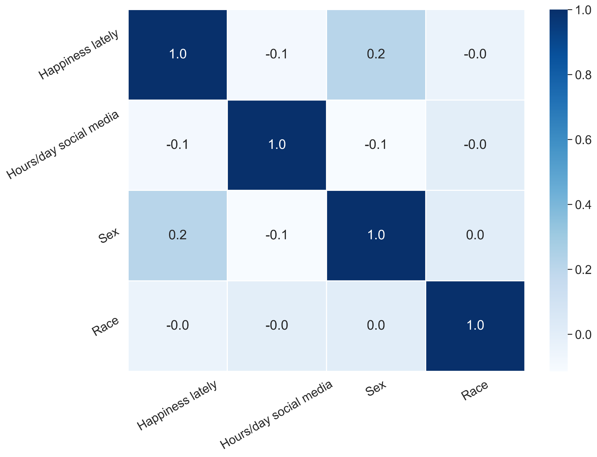
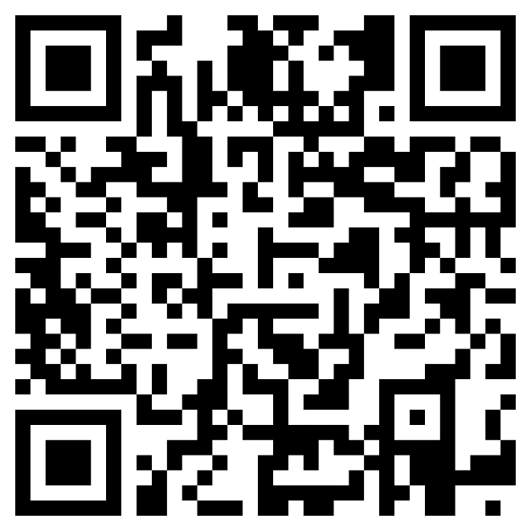
Youth Technology Use & Behavioral Health
Authors: Daniel Scheer & Gaetano Hirshout - Faculty Mentor: Dr. Erdei
Computational Science Department, University of South Carolina Beaufort, Bluffton, SC 29909
Abstract
Introduction:
To inform the potential for a relationship between the use of digital technology and adverse behavioral health outcomes two large representative datasets of American Youths were examined. From each two questions were selected, one to establish ordinal categorical data for time spent interacting with digital technology, and one to represent behavioral health outcomes.
Purpose:
The Youth Risk Behavior Survey (YRBS) administered by the Centers for Disease Control and Prevention has since 1991 collected data [1] biennially from a representative sample of American Youths. Its purpose is to monitor the effectiveness of public health interventions by observing health-related behaviors [2]. In 2021 the United States Surgeon General issued an urgent public health advisory stating that “from 2009 to 2019, the proportion of high school students reporting persistent feelings of sadness or hopelessness increased by 40%; the share seriously considering attempting suicide increased by 36%; and the share creating a suicide plan increased by 44%” [3]. While this trend of increasing negative indicators of behavioral health outcomes has been observed to coincide with an increase in the use of digital technology there is little convincing evidence to establish causation [4]. As the YRBS question regarding technology use is broad based, and therefore lacks specificity to the type of media that young people are interacting with, an additional large dataset was also evaluated to provide data specific to social media use. The Monitoring the Future (MTF) Public-Use Cross-Sectional Datasets [5] was examined with permission from the University of Michigan.
Results
Research Question
Is there a difference in self-reported indicators of adverse behavioral health outcomes among self-reported heavy users of digital technology?
YRBS Data
H0 Null Hypothesis
There is no relationship between persistently feeling sad or hopeless (question 25), and time spent using digital technology (question 80).
H1 Alternative Hypothesis
There is a relationship between persistently feeling sad or hopeless (question 25), and time spent using digital technology (question 80).
MTF Data
H0 Null Hypothesis
There is no relationship between happiness (question V7302), and time spent on social networking sites (question V7685).
H1 Alternative Hypothesis
There is a relationship between happiness (question V7302), and time spent on social networking sites (question V7685).
Figure 2 actual distribution stacked histogram for YRBS
Figure 3 actual distribution stacked histogram for MTF
Chi-Squared Test of Independence (YRBS)
P-Value | Degrees of Freedom
4.2993388683043516e-280 | 6
Chi-Squared Test of Independence (MTF)
P-Value | Degrees of Freedom
2.8233542012215992e-61 | 12
Methodology
Data Retrieval & Winnowing:
Raw data retrieved in Microsoft Access format, winnowed via SQL query, imported into python via pandas library script, and assigned to a python data frame (see figure 1 below).
Data Analysis:
Actual distribution among respondents was established using a stacked histogram. Expected distribution was calculated using chi-squared test of independence to determine if a relationship was present. A P-value of .05 was determined in advance to test the hypothesis.
Figure 4 heatmap for YRBS
Figure 5 heatmap for MTF
Discussion/Implications
The use of digital technology has become so pervasive among young Americans that daily active users represent a significant portion of the sample size. The methods applied in this study found no significant relationships between screen time and behavioral health outcomes. These findings do not however negate the need for a harm reduction approach in designing technology for adolescents [6]. Nor could the underlying data’s focus on screen time as a primary metric for digital media interaction fully account for the impacts of “dispositional, developmental, and social-context differences among media users” [7]. Considering the quantity
of user data that is commoditized in the furtherance of profits by technology companies, the lack
of data available to study digital harm among vulnerable populations is of great concern [8].
With 95% of teens reporting access to a smartphone [9], studying the social and behavioral
impacts should be met with increased determination, better data collection, and transparency.
Figure 1
To view works cited, source code, and full text
please use QR code to follow link to GitHub page

